Slide 1
BEAST2 and Protracted Birth-Death model
By Femke Thon & Jolien Gay
Supervisors:
Richel Bilderbeek & Rampal Etienne
Notes:
NOTE: Some photo’s are placeholders (incomplete pics).

Slide 2
Research Question
“Does including protractedness in the BD model produce more accurate and realistic phylogenies?”

Slide 3
Subquestions
Error big enough?
Right tools used?
...

Slide 4
Introduction: What?
Speciation
Evolutionary process
Population -> distinct species (reproductive isolation)
Visualized by models

Slide 5
Introduction: What?
Standard Birth-Death model (BD)
Constant speciation and extinction rates
Number of lineages increase constant or accelerated (pull of the present)
BUT: slowdown observed towards the present
[picture]

Slide 6
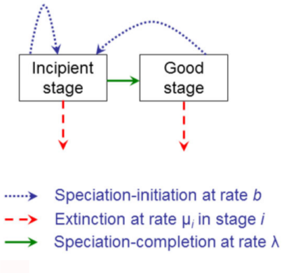
Introduction: What?
Protracted Birth-Death model (PBD)
Extension of BD
Assumes speciation takes time

Slide 7
Introduction: What?
Bayesian Evolutionary Analysis by Sampling Trees (BEAST)
Bayesian statistics
MCMC

Slide 8
Material & Methods
Material:
Simulated PBD data
BEAST2
R
Summary statistics
GitHub
Methods: 5 steps

Slide 9
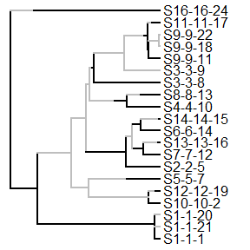
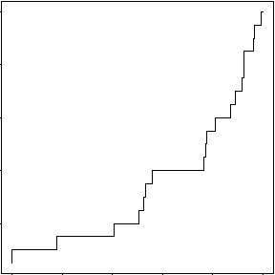
1. Create ‘true’ species trees (simulated)
Notes:
TODO: Add x and y label to picture 2 (nLTT plot)

Slide 10
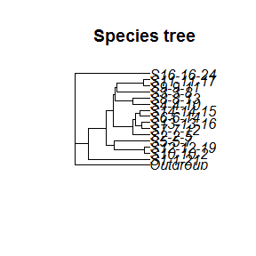
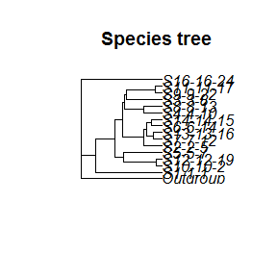
2. Sample a (monophyletic) species trees
Notes:
TODO: Make species names better visible
TODO: Add clearer title to pictures (Sampled tree 1 and 2)

Slide 11
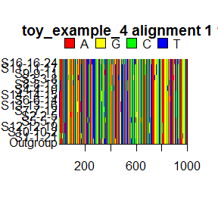
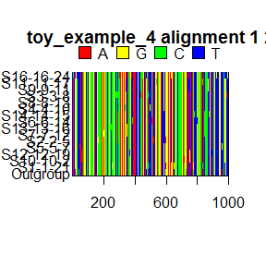
3. Convert to DNA alignment
Input BEAST2
Notes:
TODO: Clearer titles, show that these are 2 random draws sampled tree 1
Q: Should we show the 2 drawn alignments from sampled tree 2 also? Not too much stuff happening in one dia?

Slide 12
4. Infer a posterior (BEAST2)
Output BEAST2
Notes:
TODO: Find picture of posterior Toy example 4

Slide 13
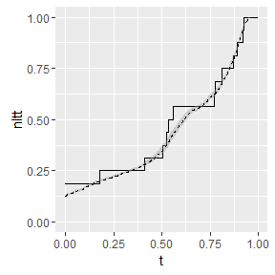
5. Compare posterior with true species tree (step1)
Notes:
TODO: Add legend

Slide 14
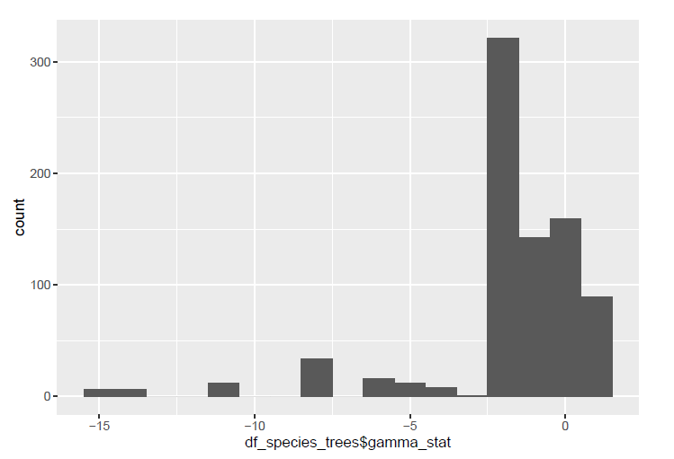
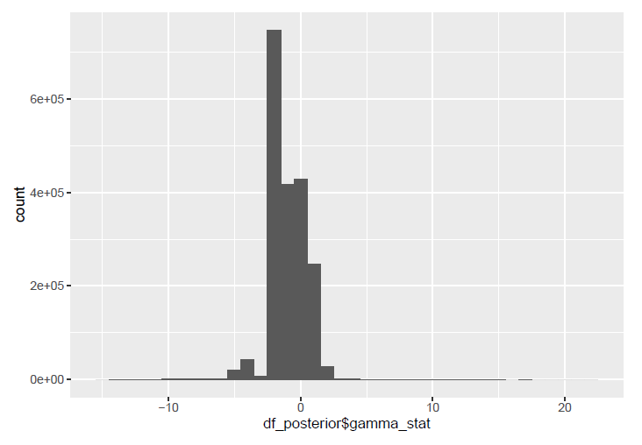
Results
Distribution of gamma statistics

Slide 15
Results
Distribution of ... (Femke)

Slide 16
Discussion
Error gamma statistics: substantial
Error ....: ??

Slide 17
Conclusion(s)
Errors big enough BUT:
Correct gamma statistics used?

Slide 18
Questions?
Notes:
POSSIBLE QUESTIONS?:
Q1: Why did you use an outgroup?
Q2: Are the used summary statistics the best, and why?

